Slide 1

Advanced Game Prototyping
GA4401

Slide 2
13 Principles
Gameplay Design
Notes:
Video games are complex, time-consuming projects often involving hundreds of people and millions of dollars, so it's not surprising that there's no simple explanation for what defines polish in a game. In many ways, it's easier to spot where polish is lacking in a game rather than where it is present, as some much of polish is about preventing the player from noticing technical issues. Perhaps Dragon Age lead designer Mike Laidlaw summed it up best by when he said polish is when "You take a game from 'this is functional' to 'this is art.'"

Slide 3
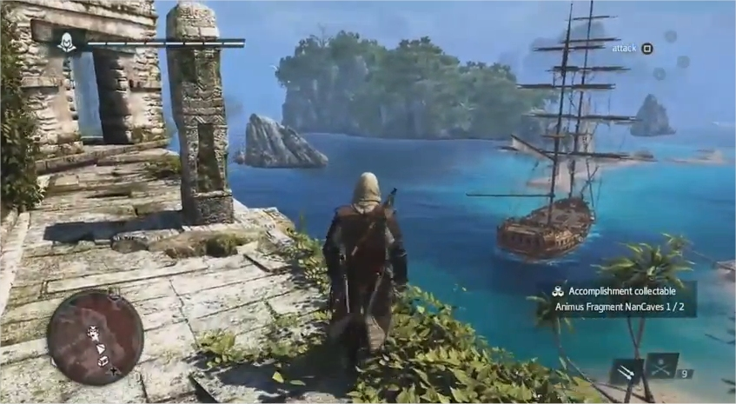
Direction
Focal Point
Level Design
Creating clear, apparent lines of sight.
Notes:
Never allow the player to guess what they should focus on. At the same time, always allow secondary subject matter, but it is the designer's job to clearly provide the primary focus at all times. This applies to both visual and visceral aspects of gameplay.

Slide 4
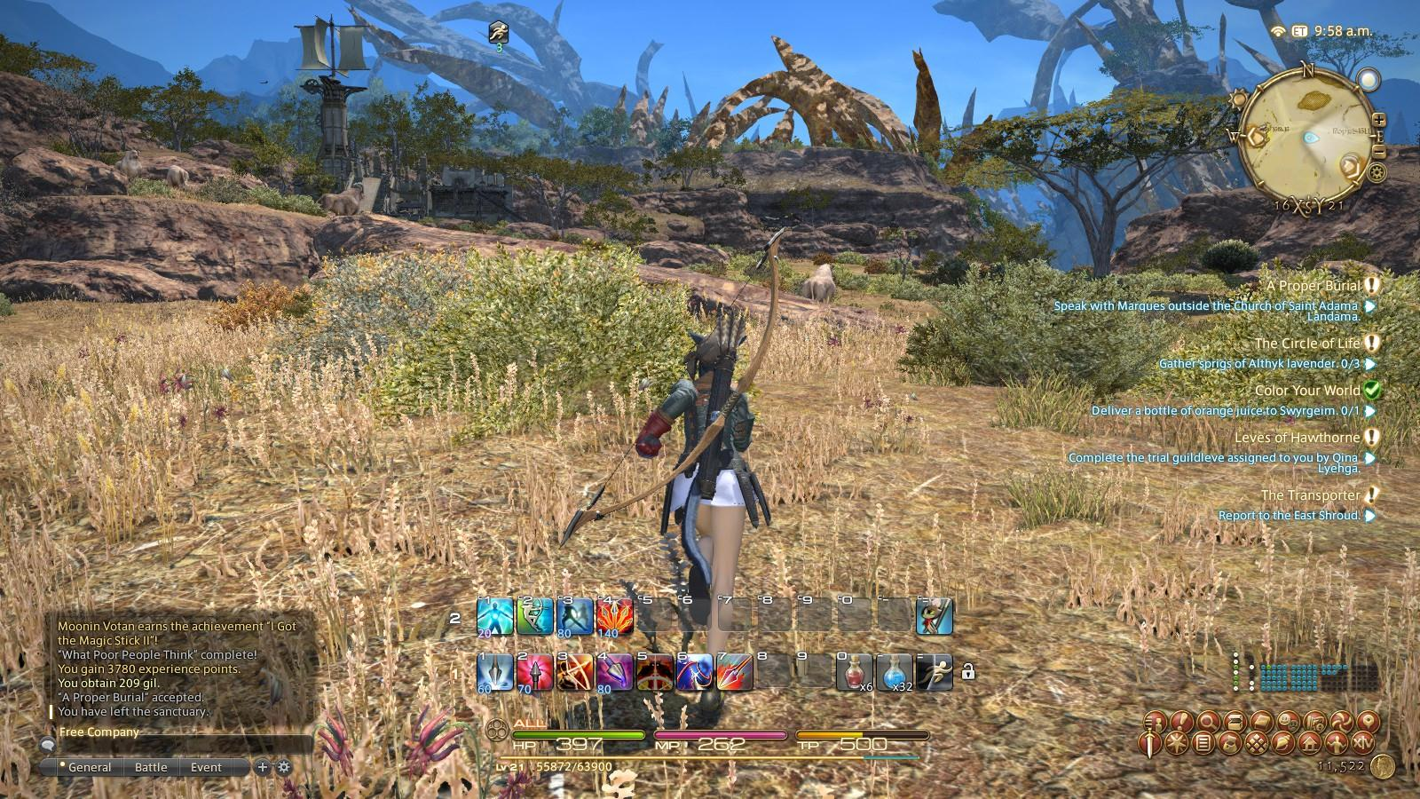
Direction
Focal Point
System Design
Clearly defined plot points and objectives
Notes:
Never allow the player to guess what they should focus on. At the same time, always allow secondary subject matter, but it is the designer's job to clearly provide the primary focus at all times. This applies to both visual and visceral aspects of gameplay.

Slide 5
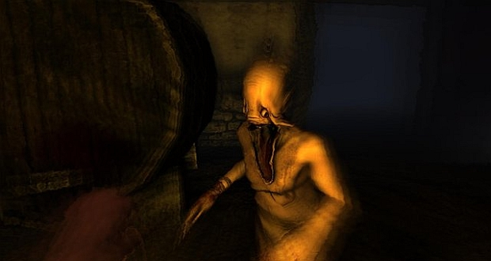
Direction
Anticipation
Level Design
A train sound effect occurs before player sees train
Notes:
Time is needed to inform the player that something is about to happen. Always factor in Anticipation when designing and implementing events and behaviors.

Slide 6

Direction
Anticipation
System Design
An energy charge builds before the lightning attack occurs
Notes:
Time is needed to inform the player that something is about to happen. Always factor in Anticipation when designing and implementing events and behaviors.

Slide 7

Direction
Announce Change
Level Design
"Cast-off" animations trigger for NPCs when the player's character boards the ship.
Notes:
Communicate all changes to the player. This short step occurs between Anticipation and the event itself.
The important part to remember is maintaining a hierarchy of notable changes.
A good rule of thumb is degree of rarity. If a change occurs a hundred times in an hour, the announcement may not be required. However, if the change occurs five times throughout the entire game experience, a number of visual cues could be needed.
This principle is so obvious, it can be taken for granted and sometimes overlooked. Be diligent in knowing what changes the player should be aware of at the correct time and on the correct event.

Slide 8
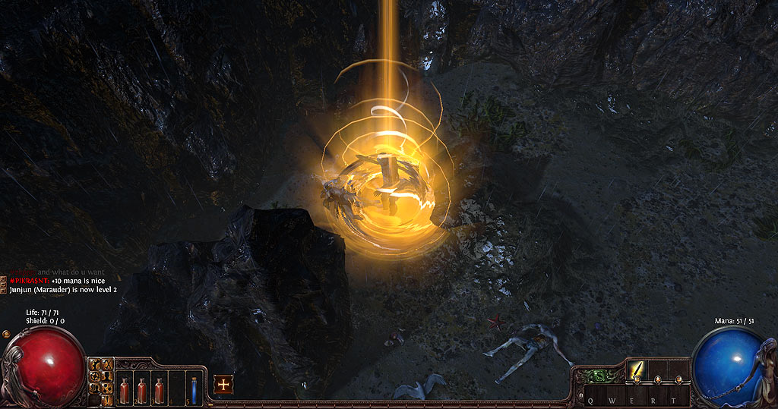
Direction
Announce Change
System Design
An on-screen notification occurs when quest criteria have been completed (i.e. "Slay 10 goblins for Farmer Bob")
Notes:
Communicate all changes to the player. This short step occurs between Anticipation and the event itself.
The important part to remember is maintaining a hierarchy of notable changes.
A good rule of thumb is degree of rarity. If a change occurs a hundred times in an hour, the announcement may not be required. However, if the change occurs five times throughout the entire game experience, a number of visual cues could be needed.
This principle is so obvious, it can be taken for granted and sometimes overlooked. Be diligent in knowing what changes the player should be aware of at the correct time and on the correct event.

Slide 9
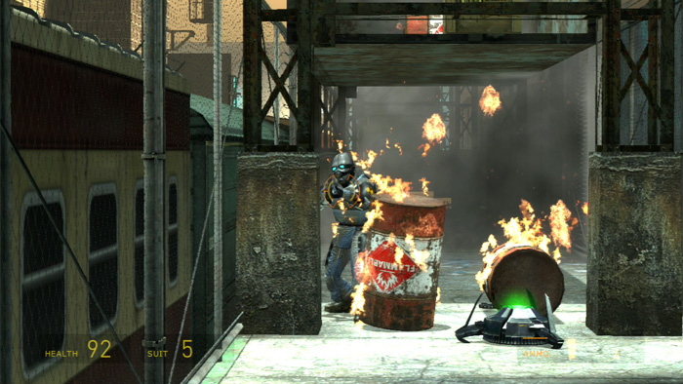
Behavior
Believable Events and Behavior
Level Design
Place destructible objects near an explosive object. This way, the explosion looks more believable.
Notes:
Every event or behavior must occur according to the logic and expectations of the player. Every action, reaction, results, emotion and conveyance must satisfy the players' subconscious acceptance test.

Slide 10
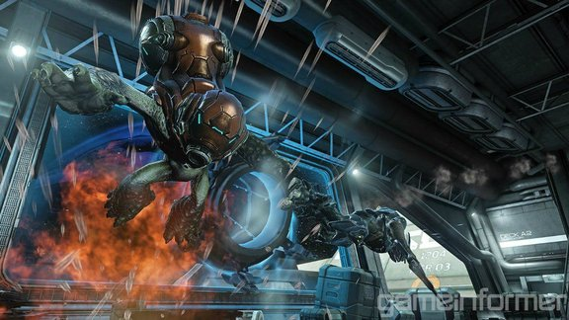
Behavior
Believable Events and Behavior
System Design
Weaker enemies run away when the advantage shifts in the player's favor.
Notes:
Every event or behavior must occur according to the logic and expectations of the player. Every action, reaction, results, emotion and conveyance must satisfy the players' subconscious acceptance test.

Slide 11
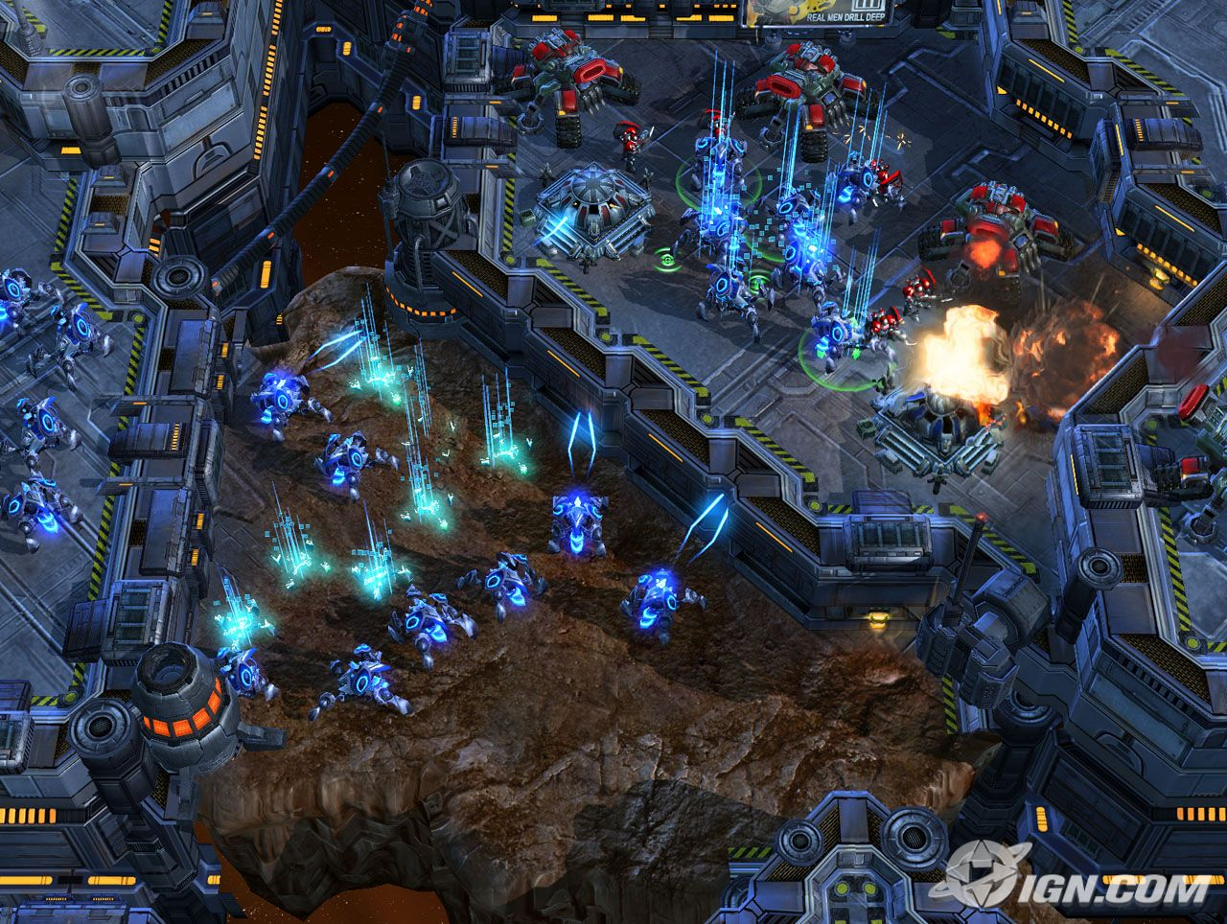
Behavior
Overlapping Events and Behavior
Level Design
Providing the player the ability to build from an appropriate list of structures.
Notes:
Dynamic is lost if only one change occurs at a time. Discover the right amount of events to occur at any given moment of time.

Slide 12
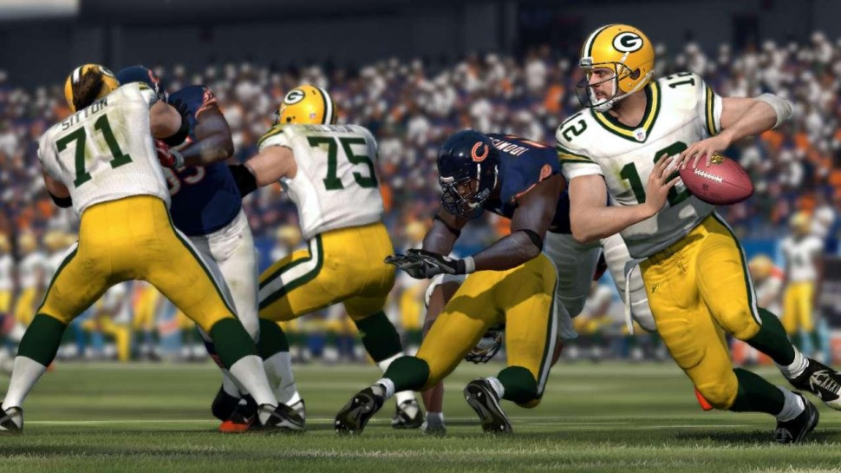
Behavior
Overlapping Events and Behavior
System Design
The action on the field before snapping a football
Notes:
Dynamic is lost if only one change occurs at a time. Discover the right amount of events to occur at any given moment of time.

Slide 13
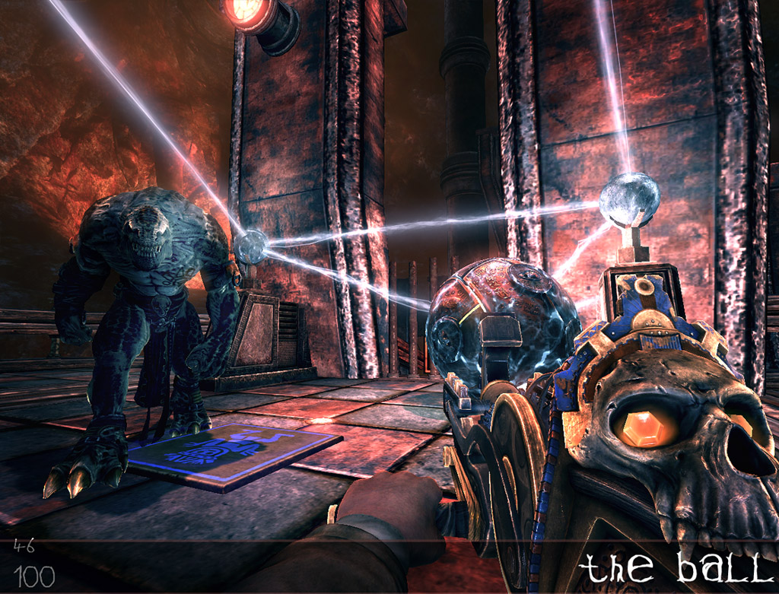
Behavior
Physics
Level Design
Ensuring a hole in the floor is the correct size for the correct purpose.
Notes:
The player's primary logic operates within the known possibilities of physics. Keep in mind gravity, weight, mass, density, force, buoyancy, elasticity, etc. Use this as the starting point, but do not be limited by it.

Slide 14

Behavior
Physics
System Design
A spark particle effect occurs when the player's vehicle scrapes the side of the concrete wall.
Notes:
The player's primary logic operates within the known possibilities of physics. Keep in mind gravity, weight, mass, density, force, buoyancy, elasticity, etc. Use this as the starting point, but do not be limited by it.

Slide 15

Behavior
Physics
Level Design
Flies in swamp level make a sound when close to the camera.
Notes:
Ask yourself, "What sound does it make when ________ happens?" "Is the sound appropriate?" "Is the sound necessary?" "Does it benefit the experience or hinder it?" If players close their eyes, the sound alone should still achieve the desired affect.

Slide 16
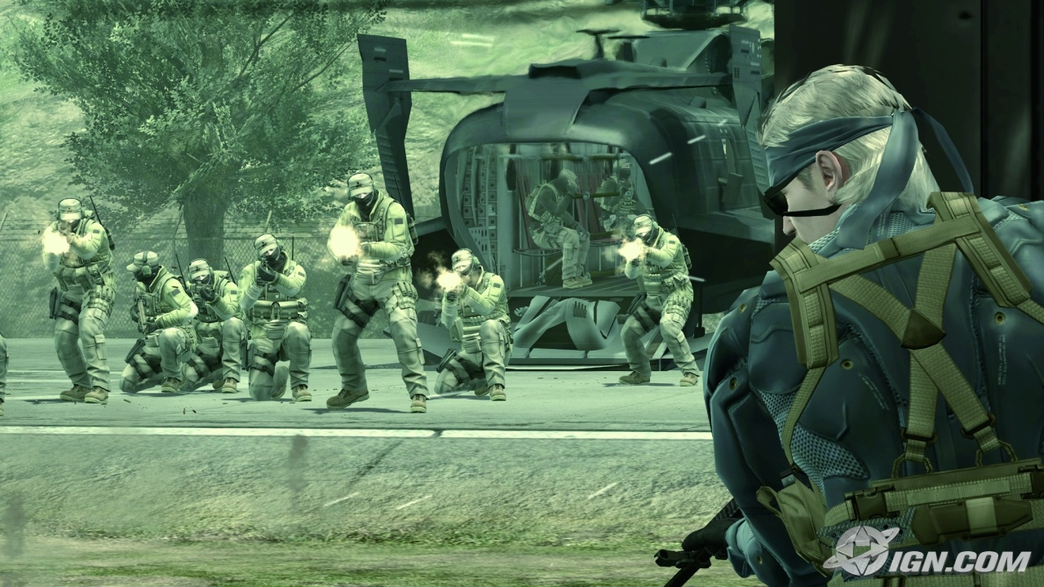
Behavior
Physics
System Design
A proximity system where sound effects volume fluctuates depending on distance of game assets.
Notes:
Ask yourself, "What sound does it make when ________ happens?" "Is the sound appropriate?" "Is the sound necessary?" "Does it benefit the experience or hinder it?" If players close their eyes, the sound alone should still achieve the desired affect.

Slide 17

Progression
Pacing
Level Design
Create areas for the player to admire the expansive view, versus areas where the player feels claustrophobic
Notes:
Keep in mind the desired sense of urgency, the rate in which events occur, the level of concentration required and how often events are being repeated. Spread out the moments of high concentration, mix up the sense of urgency, and change things wherever possible to achieve the proper affect.

Slide 18

Progressiong
Pacing
System Design
Create long, powerful attacks versus short, light attacks.
Notes:
Keep in mind the desired sense of urgency, the rate in which events occur, the level of concentration required and how often events are being repeated. Spread out the moments of high concentration, mix up the sense of urgency, and change things wherever possible to achieve the proper affect.

Slide 19
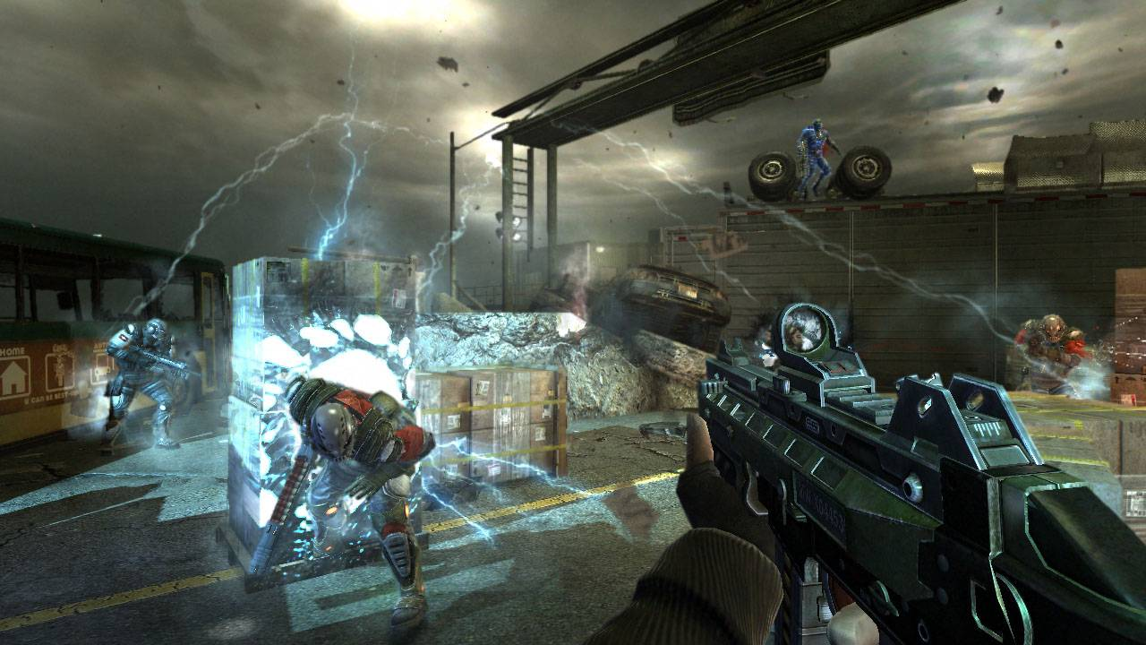
Environment
Spacing
Level Design
Lay out the appropriate amount of space for the appropriate number of enemies to maneuver correctly.
Notes:
Understand how much space is available both on-screen and in-world, recognize the spatial relationship between elements and take into account the effects of modifying those spaces

Slide 20
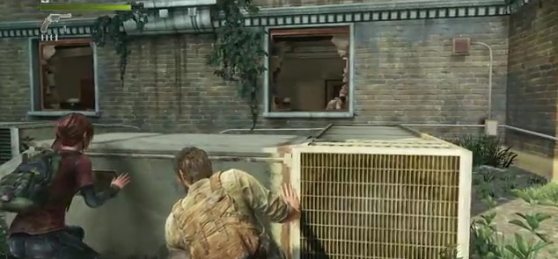
Environment
Spacing
System Design
Changing animations based on environment.
Notes:
Understand how much space is available both on-screen and in-world, recognize the spatial relationship between elements and take into account the effects of modifying those spaces

Slide 21
Method
Linear versus Component design
Level Design
Blocking out vs iteration.
Notes:
Linear Design involves solving challenges as they come. All solutions and possibilities hold the same institutional value. Focus can be lost with this method, but it provides creative and spontaneous solutions.
Component Breakdown involves systemic categorization and forming a logical hierarchy of all solutions. This method can restrict innovation but preserves clarity of primary design objectives.
This principle does not mean designers must choose one or the other. There are times during development where one method is more appropriate than the other.
For instance, pre-production provides plenty of time for breaking down a sequence of events. However, when the publisher drops a "must have" change after pre-production, linear design can provide an acceptable solution quickly.

Slide 22
Method
Linear versus Component Design
System Design
Wide vs Tall design
Notes:
Linear Design involves solving challenges as they come. All solutions and possibilities hold the same institutional value. Focus can be lost with this method, but it provides creative and spontaneous solutions.
Component Breakdown involves systemic categorization and forming a logical hierarchy of all solutions. This method can restrict innovation but preserves clarity of primary design objectives.
This principle does not mean designers must choose one or the other. There are times during development where one method is more appropriate than the other.
For instance, pre-production provides plenty of time for breaking down a sequence of events. However, when the publisher drops a "must have" change after pre-production, linear design can provide an acceptable solution quickly.

Slide 23

Foundation
Player
Level Design
Setting up the player in hopes of making them jump out of their seat.
Notes:
How does the player factor into this? How does the player interact with everything that has been designed? More than just device input, address how the player contributes to the experience. If it's a good idea and you're able to convey it correctly but the player is not into it, change it or scrap it!

Slide 24
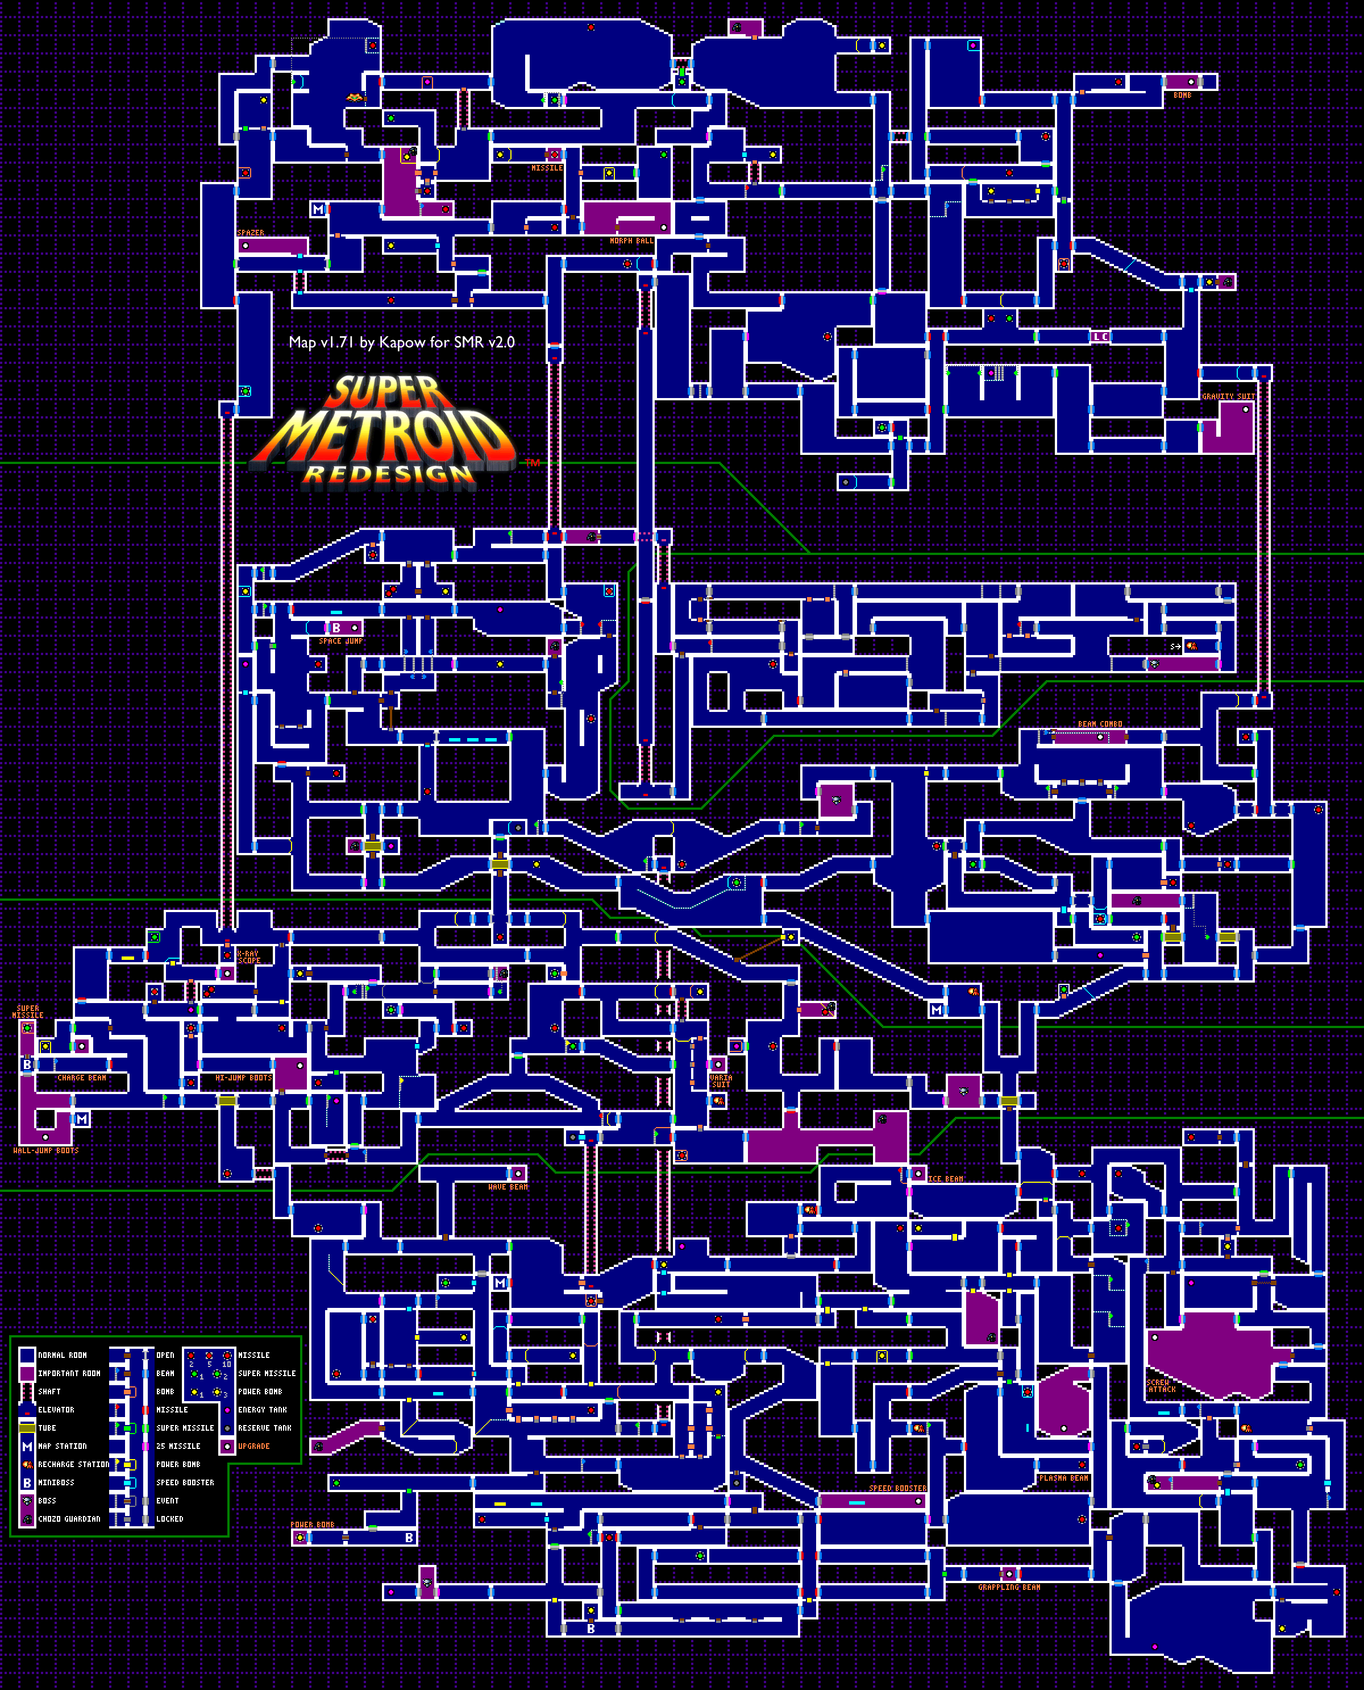
Foundation
Player
System Design
Orchestrating progression so that the player feels empowered, determined, anxious, etc.
Notes:
How does the player factor into this? How does the player interact with everything that has been designed? More than just device input, address how the player contributes to the experience. If it's a good idea and you're able to convey it correctly but the player is not into it, change it or scrap it!

Slide 25
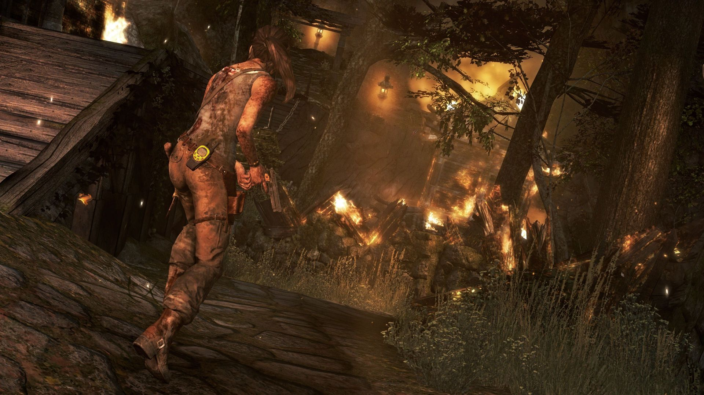
Foundation
Communication
Level Design
Using the elements of the environment so the player is compelled to travel in the correct direction.
Notes:
Is the appropriate team member correctly aware of the objective? Are the appropriate developers clear on the solution? If it's a good idea but you can't communicate it correctly, it might as well be a bad idea because it's very likely to be received as such.

Slide 26
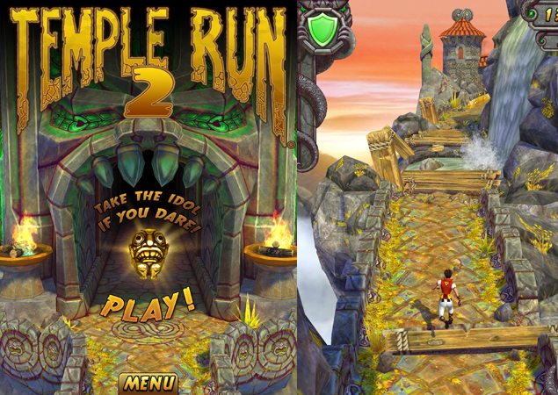
Foundation
Communication
System Design
Using visual cues so the player learns when to punch rather than kick, jump rather than strafe, etc..
Notes:
Is the appropriate team member correctly aware of the objective? Are the appropriate developers clear on the solution? If it's a good idea but you can't communicate it correctly, it might as well be a bad idea because it's very likely to be received as such.

Slide 27

Foundation
Appeal
Level Design
Running down the street is not fun, but running down the street while being pursued by government secret agents is.
Notes:
When addressing anyone, ask yourself, "Does this draw the audience in?" This applies to (but is not limited to) the player, the spectator, your fellow developers, the publisher, and their marketing team. If it's not a good idea, there's no need to continue until it becomes a good idea or is replaced by something better.

Slide 28
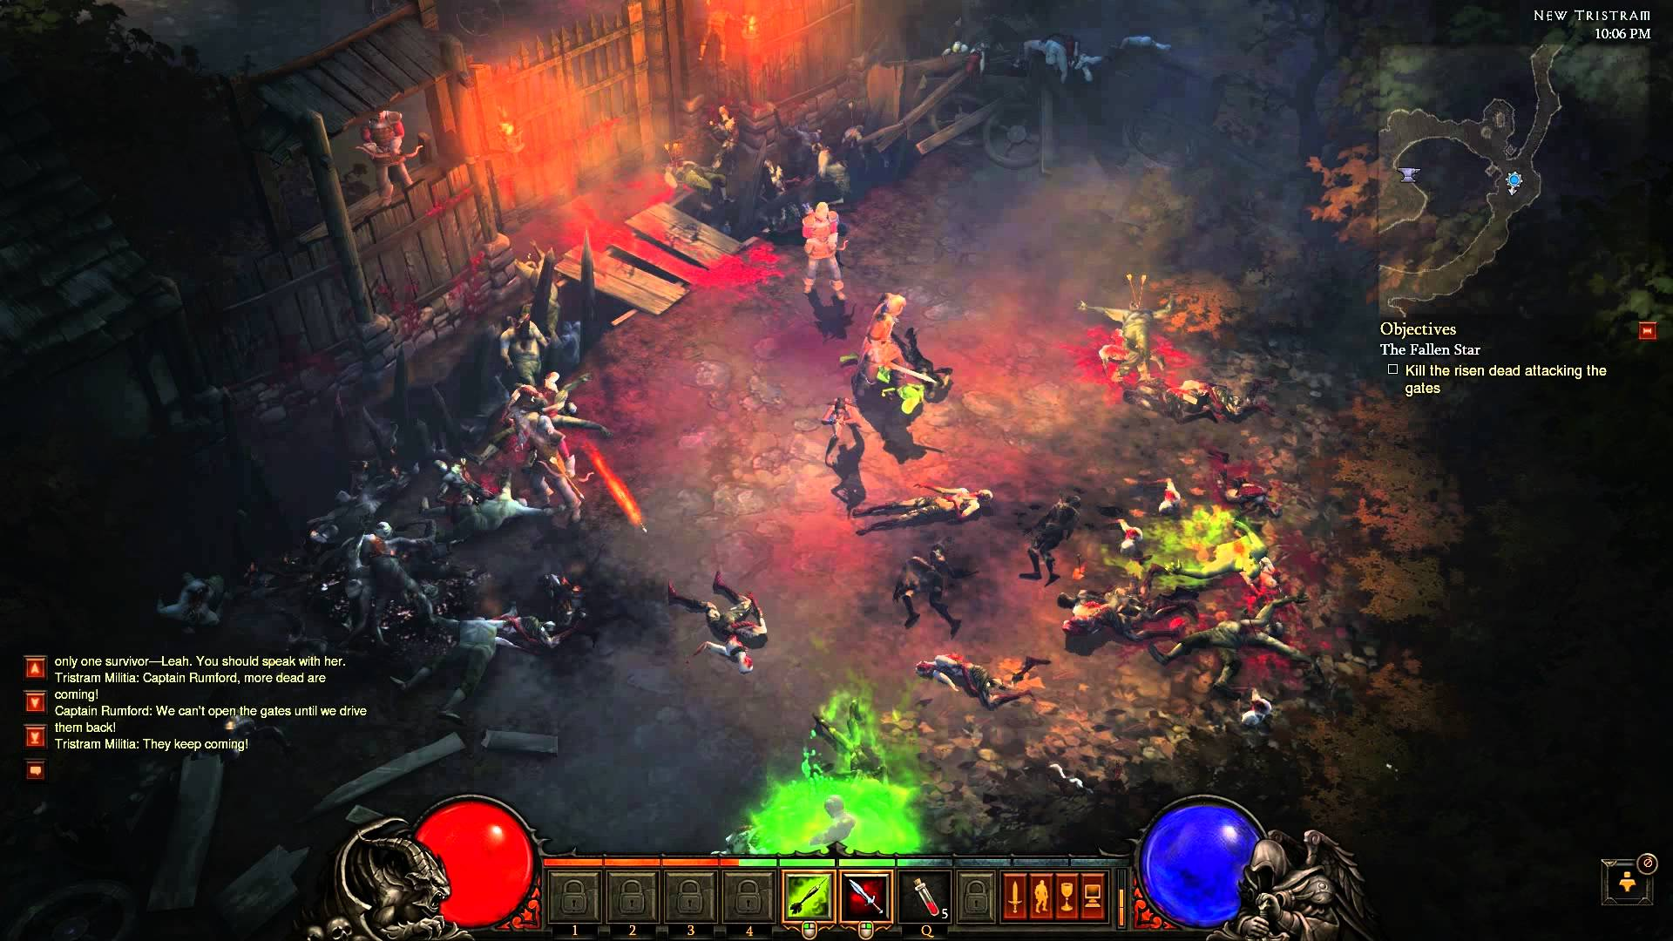
Foundation
Appeal
System Design
Punching can be fun but when the camera shakes on impact, it's even more fun.
Notes:
When addressing anyone, ask yourself, "Does this draw the audience in?" This applies to (but is not limited to) the player, the spectator, your fellow developers, the publisher, and their marketing team. If it's not a good idea, there's no need to continue until it becomes a good idea or is replaced by something better.

